Slide 1
SECURING MODERN SOFTWARE

Slide 2


The rules of the game have changed Business success depends on developing GREAT software, faster
2
Notes:
Software is no longer a boutique industry that only matters to a small set of companies. Software helps companies directly engage their markets in order to promote the brand, increase customer loyalty, and stay ahead of competition. Everyu company is becoming a software company.

Slide 3

The movement to modern software is essential
Agile & DevOps
Microservices/APIs
Containers/PaaS
Cloud Adoption
3
Notes:
The successful company in every category is the one that can produce great software fast. The need for speed and agility has driven the evolution of the Software Development Lifecycle (SDLC) towards “New Stack” technologies.
Agile/DevOps
APIs
Containers
Cloud

Slide 4


TRADITIONAL APPSEC: LEGACY TOOL SWAMP
Disparate, static, disconnected, inaccurate; requires an army of specialists to interpret results
SAST Full Scan
Manual Pentesting
IDE
Spellcheckers
SCA
NGWAF
DAST
WAF
Manual Code Review
SAST
Quick Scan
Fuzzing
IPS
4
Notes:
But AppSec has not kept pace with this evolution – to do appsec today you have to buy a dozen different tools
AND hire a staff of experts to run each one of them. Too many slowdowns, too many silos, too much friction

Slide 5


TRADITIONAL APPSEC: IMPOSSIBLE ECONOMICS
10X more code, faster
HUGE RISK
applications to run the business
tools budget
specialized security staff
time
5
Notes:
So the economics are impossible….
Huge gap between what we can achieve with the tools and staff we have
And where we need to be in the market!

Slide 6
MODERN SOFTWARE DEVELOPMENT SPEED AND SECURITY ARE HELD BACK BY A 15-YEAR-OLD, SCAN-AND-PERIMETER-BASED APPLICATION SECURITY MODEL
THE ROOT PROBLEM
AppSec needs to evolve with the SDLC
6
Notes:
At the core, this is because we’re still doing security THE OLD WAY – scanning and firewalling

Slide 7
THE MOVE TO MODERN SOFTWARE SECURITY
Legacy: SCAN AND FIREWALL MODEL
outside-in, resource-intensive
Disruptive, bottleneck
Can’t keep up, even with army of experts
After the fact, inaccurate
Snapshot in time
Tool soup, security silos
Modern: EMBEDDED MODEL
inside-out, sensor-driven
Embedded, works in flow, frictionless
Force multiplier, no experts required
Direct observation, instant feedback
Continuous, always-on
One platform across dev, sec, ops
to
Notes:
Contrast’s platform is Application Security for the modern SDLC. It evolves companies from a SCAN and FIREWALL model that works from the outside-in
to
The Embedded Model – with sensor-driven security that works from the inside out.
Works frictionlessly from within your applications
DISTRIBUTED force-multiplier that allows you to scale security
Instant – always-on feedback
A single platform across Dev Sec and Ops

Slide 8
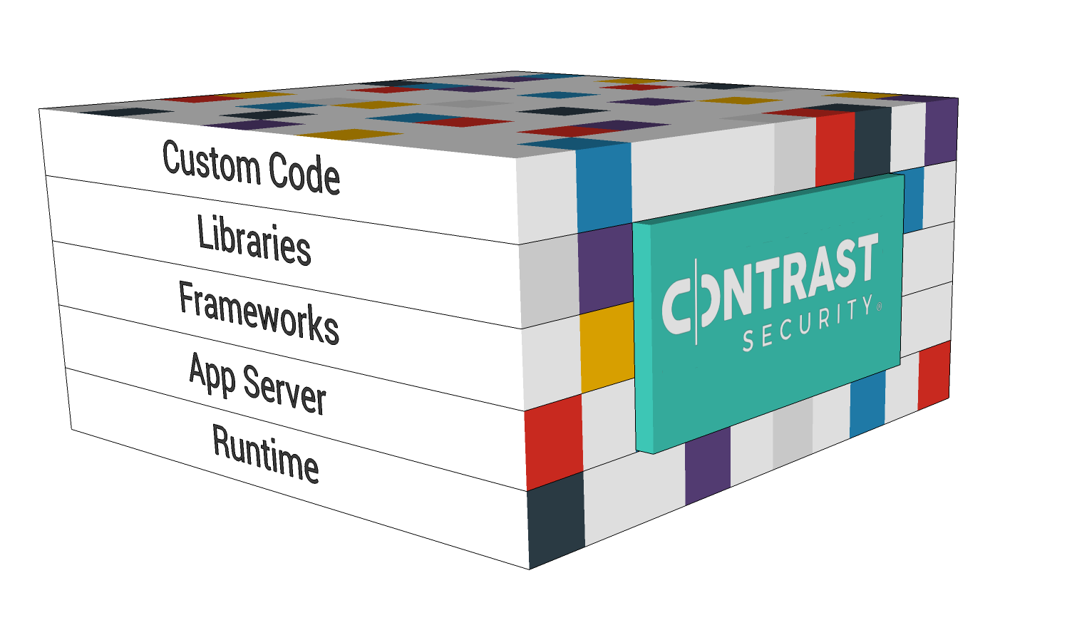
CONTRAST’S PATENTED EMBEDDED MODEL
first to market with code-level security instrumentation
Dynamic binary code instrumentation: sensors embedded in code provide direct observation
No need to modify or recompile: sensors woven into code at run-time
Always on, 24x7: continuous; no “stop and scan”
Proven approach: same instrumentation approach used by APM leaders (e.g., New Relic, AppDynamics, Dynatrace)
Notes:
The key idea is the use of dynamic instrumentation. Software instrumentation is simple in concept – you just add “sensors” to a piece of software so that you can see what’s going on inside it.
You don’t have to modify the source code, recompile, retest, or redeploy
SO you can DIRECTLY measure security from insider the app itself.
Faster
More accurate
And WAY WAY easier to use

Slide 9


HOW CONTRAST SECURITY WORKS
Your Application or API
IAST for pre-production assessment
Detects vulnerabilities in both custom code and libraries during normal usage
✘
Exploit Prevented
RASP protects production apps
Prevents exploits in production applications
Vulnerability
Confirmed
HTTP Sensors
Code Sensors
Data Flow Sensors
Control Flow Sensors
Library Sensors
Config Sensors
Backend Sensors
Notes:
NOTICE that we didn’t need to attack the application…. So ANYONE can do it.
New technology to prevent vulnerabilities from being exploited
Allows you to continue to operate, even WITH insecure libraries

Slide 10



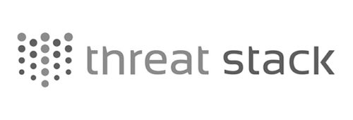






Continuous unified appsec woven Into the SDLC
Application Artifacts
SDLC
Development
CI/CD/QA
Operations
IAST/RASP
IAST/RASP
IAST/RASP
Contrast Instrumentation
Notes:
Today’s pipeline for Spring Petclinic
How do we layer security on it without screwing it all up?
We’ll use IAST is going to find vulnerabilities in DEV – both custom code and open source libraries
We’ll use IAST + RASP in CI/CD – to verify that vulns are detected and RASP is verified before we go to prod
Then we’ll use RASP in production for attack visibility
AND to prevent any new or remaining vulnerabilities from being exploited
It’s critically important that you don’t just focus on DEVSEC – You have to consider OPS as well.

Slide 11





CONTRAST DEPLOYS WITH YOUR APPLICATION
IDE
Jenkins/Circle CI
Chef/Ansible/Puppet
NPM/RPM/Nuget
Docker
Kubernetes
Whatever…
Wherever…
Notes:
In Contrast Security there is only one agent – it handles IAST, OSS, and RASP – just different operation modes and licensing.
So effectively, it becomes part of your application. However you deploy your apps and wherever you run them, the security just goes with them

Slide 12




TANGIBLE BUSINESS BENEFITS
SPEED AND SCALE
GAME-CHANGING ECONOMICS
REMARKABLE ACCELERATION
ENHANCED SECURITY
TOP 3 SOFTWARE COMPANY
FORTUNE 10 FINANCIAL SERVICES COMPANY
TOP 3 GLOBAL INSURANCE COMPANY
MAJOR HEALTHCARE COMPANY
1400+ apps secured with less than one FTE
50% reduction in pen testing costs
3X
increase in software release velocity
2.2M
application-layer attacks protected every month
12
Notes:
These are actual representative tangible business benefits enjoyed by some of our customers.

Slide 13




BENEFITS ACROSS THE ORGANIZATION
CIO/CISO
SECURITY TEAM
CTO/DEVELOPMENT TEAM
OPS TEAM
Close the software security (talent) gap
Transform IT business model with game-changing economics
Give all apps first-class security status
Eradicate software security backlog
Focus on more strategic security initiatives
Operate at DevOps speed
No disruptions/delays
Measurable code quality improvements
Works with preferred tools and existing processes
Zero day protection
Real-time protection; no need to update rules
Eliminates alert fatigue
Equal coverage across new and legacy apps
Notes:
Contrast provides benefits across the organization and encourages unity of purpose and security culture. Development organizations check in cleaner code, reduce friction with security
teams, and accelerate the delivery of secure software. Security organizations are freed from the burden of manual processes and are able to focus on more strategic tasks while becoming the “good guys”
in the enablement of a faster, more secure, software delivery pipeline. Ops teams get detailed attack forensics, automatic exploit prevention, and the minimization of false alarms.

Slide 14
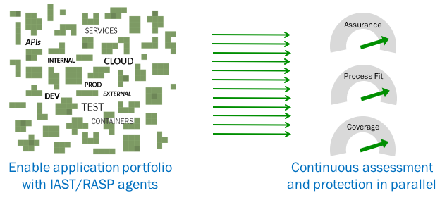
SUMMARY: SDLC + APPSEC AT SCALE
Notes:
Contrast allows you to scale AppSec across your entire application portfolio and across the SDLC.

